Slide 1
Computer Networks

Slide 2
Question
A signal is produced by varying the intensity of a specific type of energy over time through an appropriate medium. What are the types of energy that can be used for this purpose?

Slide 3
Answer
The main types of energy used are electrical energy, electromagnetic energy, light (optical) energy.

Slide 4
Question
Why Throughput < Bandwidth?

Slide 5
Answer
In real networks, we never achieve full bandwidth due to:
Network congestion (too many devices)
Packet loss & retransmissions
Protocol overhead (headers, control data)
Delays and interference
Actual data transfer (throughput) is always less than theoretical maximum (bandwidth).

Slide 6
Question
What is Pulse Code Modulation (PCM)?

Slide 7
Answer
Pulse Code Modulation (PCM) is used in digital communication systems to convert analog signals such as voice into digital form for transmission, and then reconstruct them back into analog form at the receiver.
Three steps of PCM:
1. Sampling: The analog signal is measured at regular time intervals. (Takes “snapshots” of the signal)
2. Quantization: Each sample is assigned a closest numerical value. (Rounding the signal levels)
3. Encoding: The values are converted into binary code. (0s and 1s)

Slide 8
Question
A communication link has a data rate of 10 Mbps and a propagation delay of 50 milliseconds.
Explain what the delay-throughput product.
Calculate the delay-throughput product.

Slide 9
Answer
Propagation Delay: The time taken for a signal to travel from the sender to the receiver through a transmission medium.
(a) Delay-Throughput Product: The amount of data (in bits) that can be presented in the communication link at any given time.
(b) Delay–Throughput Product = Data Rate × Propagation Delay
=10×10⁶ bits s⁻¹ × 0.05 s
=500,000 bits

Slide 10
Question
What is Manchester Encoding in digital communication?

Slide 11
Question
Using Manchester Encoding, draw the timing diagram for the 8-bit binary pattern: 10101100. Assume the signal starts with a high-to-low transition for a ‘0’ and a low-to-high transition for a ‘1’.

Slide 12
Question
How does a Layer 2 switch build its Forwarding Table in a Local Area Network (LAN)? Explain the process.

Slide 13
Answer
PC1 sends data → Switch learns PC1 MAC on Port 1
Destination unknown → Switch floods
PC2 replies → Switch learns PC2 MAC on Port 2
Next time → Switch sends directly (no flooding)

Slide 14
Question
What are Layer 2 loops in a LAN, and why they problematic?

Slide 15
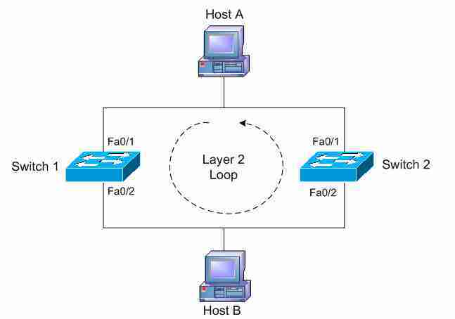
Answer
A Layer 2 loop is a condition in a Local Area Network (LAN) where frames circulate continuously between switches due to multiple redundant paths.

Slide 16
Layer 2 refers to the Data Link Layer in the OSI model. It is responsible for sending data frames within a local network (LAN) using MAC addresses.
Layer 2 loops happen because for reliability, networks often connect switches with redundant links. But Layer 2 (Ethernet – The most common Layer 2 technology used in LANs) does not have a built-in mechanism like TTL (Time to Live – A field used in Layer 3(Network Layer)) to stop frames. Ethernet does not track how long a frame has been traveling. So frames can loop forever.
Loops are problematic because they lead to broadcast storms, Mac address table instability, multiple frame copies, and network congestion. These issues can severely degrade network performance.

Slide 17
Question
Explain the difference between Physical and Logical LAN topologies. Provide one example for each to illustrate your answer.

Slide 18
Answer
Physical topology refers to the actual physical layout of devices and cables in a network.
Logical topology refers to how data flows between devices, regardless of physical connections.
For example, a network may have a star physical topology where all devices are connected to a central hub, but it operates as a logical bus because the hub broadcasts messages to all connected devices.

Slide 19
Question
In the Ethernet (or IEEE 802.3) frame format, the Destination MAC address appears as the first field in the frame header. Why is it important to place the destination address at the beginning of the frame?

Slide 20
Answer
The destination MAC address is placed at the beginning of the Ethernet frame so that network devices (Switches/NICs) can quickly determine whether the frame is intended for them or where it should be forwarded.
If not relevant, the device can discard or forward the frame quickly without processing the entire frame
This improves efficiency, enable fast forwarding, reduce unnecessary processing.

Slide 21
Question
Draw and label the Ethernet frame header format, clearly indicating the size of each field in bytes.

Slide 22
Answer
Preamble | SFD | Destination MAC | Source MAC | Type/Length | Data | FCS
7 bytes | 1 byte | 6 bytes | 6 bytes | 2 bytes | 46-1500 bytes | 4 bytes

Slide 23
Question
When one host in a Local Area Network (LAN) wants to communicate with another using IP, it needs the destination's MAC address for the Ethernet frame.
Describe what happens when the destination MAC address is not already known to the sender.
What kind of message is sent and how is it delivered on the LAN?

Slide 24
Answer
When the destination MAC address is unknown, the sender initiates the Address Resolution Protocol (ARP).
First the sender checks its local ARP cache to see if the mapping exists.
If not found, the sender pauses the IP packet delivery and creates an ARP Request packet.
This request basically asks: “Who has this IP address? Tell me your MAC address”

Slide 25
Answer
b) The message is an ARP Request. It is send as a Broadcast frame.
The destination MAC address in the Ethernet header is set to all ones (FF:FF:FF:FF:FF:FF)
This ensures every device in the local network segment receives and process the request.
Only the host with the matching IP address will respond with a Unicast ARP Reply containing its MAC address.

Slide 26
Question
When one host in a Local Area Network (LAN) wants to communicate with another using IP, it needs the destination's MAC address for the Ethernet frame.
Describe what happens when the destination MAC address is not already known to the sender.
What kind of message is sent and how is it delivered on the LAN?

Slide 27
Answer
When the destination MAC address is unknown, the sender initiates the Address Resolution Protocol (ARP).
First the sender checks its local ARP cache to see if the mapping exists.
If not found, the sender pauses the IP packet delivery and creates an ARP Request packet.
This request basically asks: “Who has this IP address? Tell me your MAC address”

Slide 28
Answer
b) The message is an ARP Request. It is send as a Broadcast frame.
The destination MAC address in the Ethernet header is set to all ones (FF:FF:FF:FF:FF:FF)
This ensures every device in the local network segment receives and process the request.
Only the host with the matching IP address will respond with a Unicast ARP Reply containing its MAC address.

Slide 29
4. IP Addressing

Slide 30
IP Addresses:
An IP address is a unique logical address assigned to a device on a network to identify it and enable communication.
Types of IP Addresses:
IPv4
IPv6

Slide 31
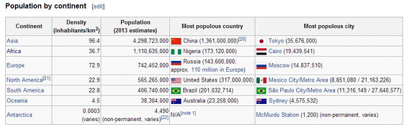
IPv4 Addresses:
An IPv4 address is a 32 bit long identifier.
Max possible IPv4 Addresses: 2³² = 4.09 Billion

Slide 32
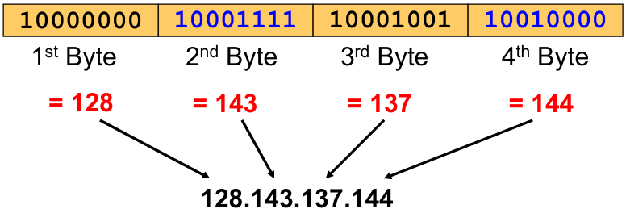
IPv4 Addresses:
IP addresses are written in dotted decimal notation.
Each byte is identified by a decimal number in the range [0-255]

Slide 33
Network prefix and Host number
An IP address is divided into two parts:
Network prefix
Host number
Network prefix identifies the network.
Host part identifies the specific device within that network.

Slide 34
How long the Network prefix is?
Before 1993 the network prefix is implicitly defined. (Class-Based-Addressing)
After 1993 the network prefix is indicated by a netmask.

Slide 35
Classful IP Addresses
Address space is divided into classes:
Class A: Network prefix is 8 bits long
Class B: Network prefix is 16 bits long
Class C: Network prefix is 24 bits long
Class is identified by the first few bits of the IP address:
Class | Starting Bits | First Octet Range
Class A | 0 | 0 - 127
Class B | 10 | 128 - 191
Class C | 110 | 192 - 223

Slide 36
Public and Private IP Addresses
To solve the shortage, IPs are divided into two as Public IP Addresses and Private IP Addresses.
A public IP is an address that is globally unique and used on the Internet.
It is Assigned by ISP, Accessible from anywhere on the Internet, Unique worldwide.
A private IP is used inside local networks (LANs) and is not visible on the Internet.
Private IPs are used to save public IP addresses.

Slide 37
Private IP ranges
Class | Range
Class A | 10.0.0.0 – 10.255.255.255
Class B | 172.16.0.0 – 172.31.255.255
Class C | 192.168.0.0 – 192.168.255.255

Slide 38
Problems with Classful IP Addressing
Wastage of IP Addresses:
The fixed class sizes cause inefficient use of IP addresses.
Class A → too large (millions of addresses)
Class C → too small (only 254 hosts)
Organizations often got more IPs than needed, wasting addresses.
Had to choose IPs from fixed sizes (A,B, or C). Cannot create custom sized networks.
Since routers had to store many individual network entries, Routing tables became large and inefficient.

Slide 39
CIDR (Classless Inter Domain Routing)
Allows flexible allocation of IP addresses by using a variable-length network prefix instead of fixed classes.
CIDR notation of an IP address: 192.168.1.0/24
24 is the Prefix length. It status that first 24 bits are the network prefix of the address. 8 bits are available for host addresses.
CIDR eliminates the concept of class A, B and C networks. Replaces it with a network prefix.
With CIDR, networks can be: (Can choose based on the need)
/8 → very large
/16 → medium
/24 → small
/30 → very small

Slide 40
5. Subnetting

Slide 41
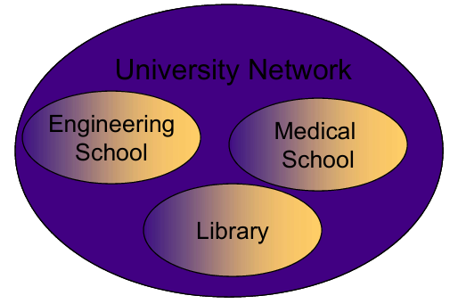
Problem:
Organizations have multiple networks which are independently managed.

Slide 42
Solution 1:
Allocate a separate network address for each network.
Problems:
Difficult Network Management
Address Wastage
Large Broadcast Domain
Lack of Security

Slide 43
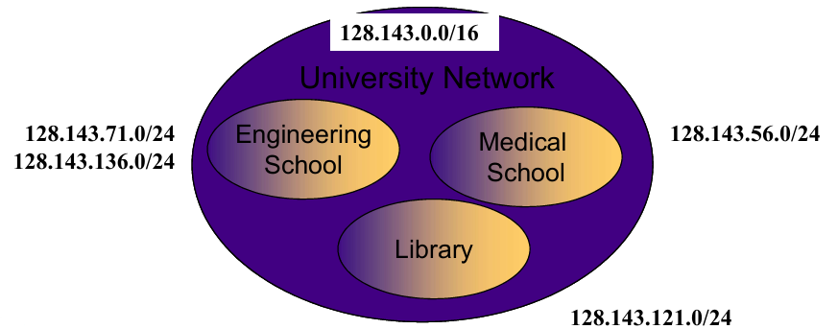
Solution 2:
Subnetting (Add another level of hierarchy to the IP addressing structure)

Slide 44
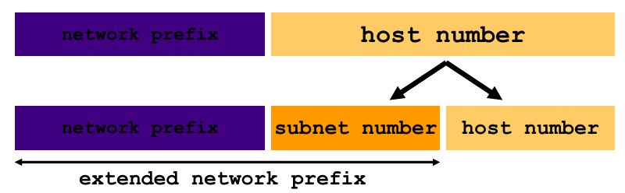
Idea of Subnetting:
Split the host number portion of an IP address into a subnet number and a smaller host number.
This results in 3-layer hierarchy.

Slide 45
Then subnets can be freely assigned within the organization.
Internally, subnets are treated as separate networks.
Subnet structure is not visible outside the organization.

Slide 46
Question
A network has IP address 192.168.1.0/24.
How many:
Subnets can be created if subnet mask is changed to /26?
Usable hosts per subnet?

Slide 47
Answer
Borrowed bits = 26 – 24 = 2 bits
Number of subnets = 2² = 4 subnets
Host bits = 32 – 26 = 6 bits
2⁶ = 64 total addresses
Usable hosts = 64 – 2 = 62 (1 for network + 1 for broadcast)

Slide 48
Question
Given 192.168.1.0/26, list all subnets.

Slide 49
Answer
Given: IP: 192.168.1.0/26
/26 means:
26bits = network
Remaining = hosts
Subnet mask = 255.255.255.192
Block size = 256 – Subnet mask value
= 256 – 192 = 64 (This is the subnet increment)
Subnets:
192.168.1.0 – 192.168.1.63
192.168.1.64 – 192.168.1.127
192.168.1.128 – 192.168.1.191
192.168.1.192 – 192.168.1.255

